Slide 1
DS4UX: How to get data with Python [HCDE598] RESTful APIs and data crawling
Johnathan Morgan & Sungsoo (Ray) Hong

Slide 2
Big Picture

Slide 3

Big picture
Data,
from where to find
and how to get?
?
Notes:
Review and
http://ruliweb.daum.net/game/search/game_map.daum?key=0

Slide 4






Big picture: Where?
Several web services have their domain-specialized databases that are designed to answer your questions
“Servers”
Hey guys, you know what?
while(True) {
Print (“Maps are
awesome!”);
}
Well, how
about
public
information?
Indeed, publicness is important.
that’s why I’m here.
At the end,
we all eat.
We eat.
Therefore
we are.
Then let‘s tweet
your dining so that
the rest of the world
knows how gorgeous
your life is!!
#LifeIsGorgeous
You know,
I know
everything.
I know my
eyes are red.
Ask the eye
color now, please!
And you know you have installed Python 3.5 in your desktop. Now WHAT TO DO?
“Client”
Your PC
Oh crap!
They are saying some weird things,
what should
I do?
Notes:
Review and
http://ruliweb.daum.net/game/search/game_map.daum?key=0

Slide 5
Big picture: Where?
These “several web services” include:
Shared knowledge and public data (e.g., Wikipedia, Data.seattle.gov, Reddit)
Map services (e.g., Google Maps, Yelp, OpenStreetMap)
Multimedia (e.g., YouTube, Spotify)
Social networks (e.g., Flicker, Twitter, Facebook, Instagram)
e-Commerce (e.g., Amazon, eBay)
Reviews (e.g., foursquare, Rotten Tomatoes)
And more. Find more at http://www.programmableweb.com/apis/directory
Notes:
Review and
http://ruliweb.daum.net/game/search/game_map.daum?key=0

Slide 6
Big picture: Then how?
Several web services provide what is called RESTful APIs* as a resource that you can access and conduct some data crawling **.
* REST – Representational State Transfer: https://en.wikipedia.org/wiki/Representational_state_transfer **Web crawler: https://en.wikipedia.org/wiki/Web_crawler
Notes:
Review and
http://ruliweb.daum.net/game/search/game_map.daum?key=0

Slide 7
Big picture: Then how?
Google Maps
RESTful API
Seattle Gov
RESTful API
Wikipedia
RESTful API
Yelp
RESTful API
Twitter
RESTful API
Reddit
RESTful API
Python
Notes:
Review and
http://ruliweb.daum.net/game/search/game_map.daum?key=0

Slide 8
Big picture: Step by Step
1) You construct a query which specifies what you want to know. 2) You cast the query to a target RESTful API.
3) Then the API will answer your query by sending a file to you which is encoded in some standardized format (e.g., JSON).
4) You access to the information by decode a file you received from the API, and save it.
+ 5) You can even periodically cast queries to REST API and let the Python save them, so that you can analyze the information later. (i.e., data crawling).
Notes:
Review and
http://ruliweb.daum.net/game/search/game_map.daum?key=0

Slide 9
Big picture: Things to learn today
1) What type of queries can we can make and : will cover this tonight. 2) How to actually cast to REST APIs ? : will cover this tonight. 3) How to decode the standardized data format you got from RESTful APIs and how to save it, so that you can access to the information? : will cover this tonight
Notes:
Review and
http://ruliweb.daum.net/game/search/game_map.daum?key=0

Slide 10

Big picture: Things to learn today
4) How can you periodically cast queries to RESTful APIs and systematically store information?
: not today :p
IMAGE CREDIT: WWW.QUICKMEME.COM & HBO
Notes:
Review and
http://ruliweb.daum.net/game/search/game_map.daum?key=0

Slide 11
Constructing a query for RESTful API with examples

Slide 12
Query Construction
RESTful APIs will answer your questions properly
only if
you construct your query based on the APIs’ specification, and
you have permission to ask questions to the APIs.
Let’s see one by one.
Notes:
Review and
http://ruliweb.daum.net/game/search/game_map.daum?key=0

Slide 13
Query Construction
Q: What do you mean by constructing a query based on APIs’ specifications?
A: This means that you construct the query by
specifying necessary parameters that are specified in the API that you are planning to use. The parameters should be documented in APIs.
Let’s see some examples.
Notes:
Review and
http://ruliweb.daum.net/game/search/game_map.daum?key=0

Slide 14
Query Construction
But before we go, wait. Parameters?
Let’s quickly take a look at the link below:
https://courses.cs.washington.edu/courses/cse154/13sp/lectures/slides/lecture09-forms.shtml#slide2
Generally, the web service receives a set of variables made from
1) name of parameter and 2) the actual value of parameter.
e.g., http://www.google.com/maps?q=MIT means the google map API receives the parameter name q (i.e., query) and the paired parameter value “MIT”. If you don’t specify the q parameter name with value, the API will not know what to find.
Notes:
Review and
http://ruliweb.daum.net/game/search/game_map.daum?key=0

Slide 15
Query Construction
#1. The case of Twitter
Notes:
Review and
http://ruliweb.daum.net/game/search/game_map.daum?key=0

Slide 16
Query Construction
https://dev.twitter.com/
https://dev.twitter.com/overview/documentation
https://dev.twitter.com/rest/public
https://dev.twitter.com/rest/reference/get/search/tweets
https://dev.twitter.com/rest/tools/console
Notes:
Review and
http://ruliweb.daum.net/game/search/game_map.daum?key=0

Slide 17
Query Construction
#2. The case of Yelp
Notes:
Review and
http://ruliweb.daum.net/game/search/game_map.daum?key=0

Slide 18
Query Construction
https://www.yelp.com/developers/documentation/v2/overview
https://www.yelp.com/developers/documentation/v2/authentication
https://www.yelp.com/developers/manage_api_keys
https://www.yelp.com/developers/documentation/v2/search_api
https://www.yelp.com/developers/documentation/v2/business
https://www.yelp.com/developers/api_console
Notes:
Review and
http://ruliweb.daum.net/game/search/game_map.daum?key=0

Slide 19
Query Construction
Q: How the APIs can check I have permission to ask questions?
A: It varies. But in general, you have limited number of queries within a certain amount of time window.
For example, Twitter allows you to ask 180 search queries within 15 minutes (see here). Yelp allows you to throw 25,000 queries per day.
So you have to be wise when you decide which parameters (e.g., query term) to throw and when.
Plus, the APIs check this via an authentication protocol called Oauth.
This guy is
not simple to
understand.
Notes:
Review and
http://ruliweb.daum.net/game/search/game_map.daum?key=0

Slide 20
HOW to Cast A Query to APIs with Python?

Slide 21
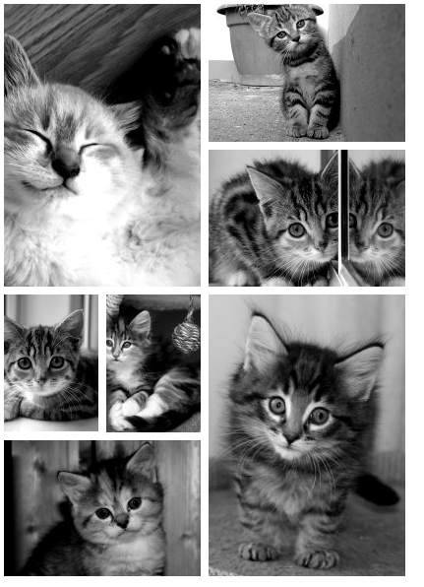
Casting a Query with Python
#1. Placekitten APIs
IMAGE CREDIT: Placekitten APIs
Notes:
Review and
http://ruliweb.daum.net/game/search/game_map.daum?key=0

Slide 22
JSON and Dictionary: Understanding How to access information with examples

Slide 23
JSON and Dictionary
Every information can be structured. Let’s see how we can structure e-mail, for example.
Subject: Tomorrow’s event~!
From: Alice Smith (alice@example.com) To: Robert Jones (roberto@example.com) ; Charles Dodd (cdodd@example.com)
Hey guys, don’t forget to call me this weekend.
Sent : 22nd of April, 2016
Private message: Yes
Notes:
Review and
http://ruliweb.daum.net/game/search/game_map.daum?key=0

Slide 24
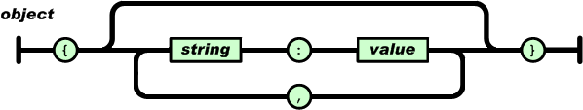
JSON and Dictionary
Introduce JSON object:
the way in which you can use to structuralize every type of information.
IMAGE CREDIT: http://www.json.org/
Notes:
Review and
http://ruliweb.daum.net/game/search/game_map.daum?key=0

Slide 25
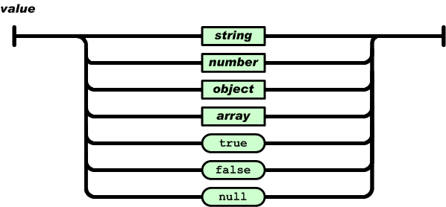
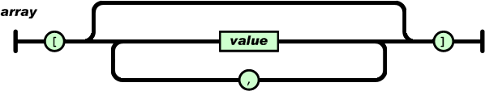
JSON and Dictionary
IMAGE CREDIT: http://www.json.org/
Notes:
Review and
http://ruliweb.daum.net/game/search/game_map.daum?key=0

Slide 26
JSON and Dictionary
Then how can we structuralize the previous e-mail with JSON object?
{
"subject": "Tomorrow's event~!“, "from": "Alice Smith (alice@example.com)", "to": [ "Robert Jones (roberto@example.com)", "Charles Dodd (cdodd@example.com)" ], "message": { "text": "Hey guys, don't forget to call me this weekend", "language": "english" }, "private": "true" }
Notes:
Review and
http://ruliweb.daum.net/game/search/game_map.daum?key=0

Slide 27
JSON and Dictionary
This seems very^100 familiar. Isn’t it?
“JSON is more useful as a Python dictionary.”
- Prof. David McDonald, UW HCDE
Notes:
Review and
http://ruliweb.daum.net/game/search/game_map.daum?key=0

Slide 28
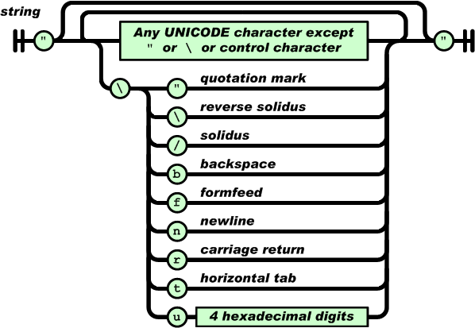
JSON and Dictionary
JSON and Python dictionary seems very similar, but not exactly the same thing. (visit http://jsonlint.com/)
For example,
The JSON string should be
always starts from double quotation,
whereas a Python dictionary allows
single quotation.
IMAGE CREDIT: http://www.json.org/
Notes:
Review and
http://ruliweb.daum.net/game/search/game_map.daum?key=0

Slide 29
JSON and Dictionary
The JSON – DICT – JSON pipeline
RESTful API
Your desktop
Python
program
HDD
JSON
Dict
JSON
Stage 1. RESTful API provides
you a JSON
Stage 2. Request package automatically coverts
a JSON file to a dictionary
to load that JSON
to your python program.
(You can do some process
after a JSON is converted
to a dictionary)
Stage 3. After you finish
process a dictionary, you save a dictionary
as a JSON again in your HDD. This will allow you to load that again later.
Notes:
Review and
http://ruliweb.daum.net/game/search/game_map.daum?key=0

Slide 30
JSON and Dictionary
Thus, you need to know
How to convert a JSON file to a dictionary, and convert a dictionary to a JSON.
Notes:
Review and
http://ruliweb.daum.net/game/search/game_map.daum?key=0

Slide 31
JSON and Dictionary
Fortunately, this is easy.
Just remember dump and load
Instances in
Python (i.e., disc)
Dump
Files in
HDD or APIs
(i.e., JSON)
Load
Notes:
Review and
http://ruliweb.daum.net/game/search/game_map.daum?key=0

Slide 32
JSON and Dictionary
When you load
import json
Jsdict = {}
Fin = open(“some_input.json”, “r”)
Jsdict = json.load(Fin)
And when you dump
import json
Jsdict = {}
…
Fout = open(“some_output.json”, “w”)
json.dump(Jsdict, Fout, indent = “4”)
Fout.close()
Notes:
Review and
http://ruliweb.daum.net/game/search/game_map.daum?key=0

Slide 33
JSON and Dictionary
Demonstration:
Open jsonexample.py
Notes:
Review and
http://ruliweb.daum.net/game/search/game_map.daum?key=0

